Slide 1
Security & cryptography final project
Barna tudor-cristian

Slide 2
Algorithms
Symmetric key:
DES – fixed key size (64-bit key, only 56 are used)
Blowfish – variable length key (32–448-bit)
Both are variations of Feistel Cipher
Asymmetric key:
RSA – not implemented

Slide 3
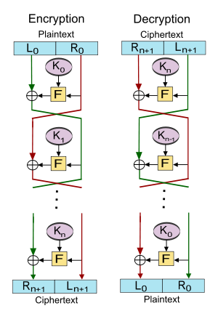
Feistel Cipher
Generate the Round Keys (Key Schedule)
Split input in halves
Apply a Round Function: F(One Half, Round Key)
XOR the output with the other half
Repeat for N rounds
To decrypt, reverse the order of the Round Keys

Slide 4
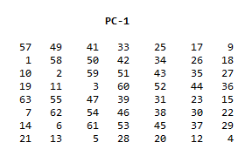
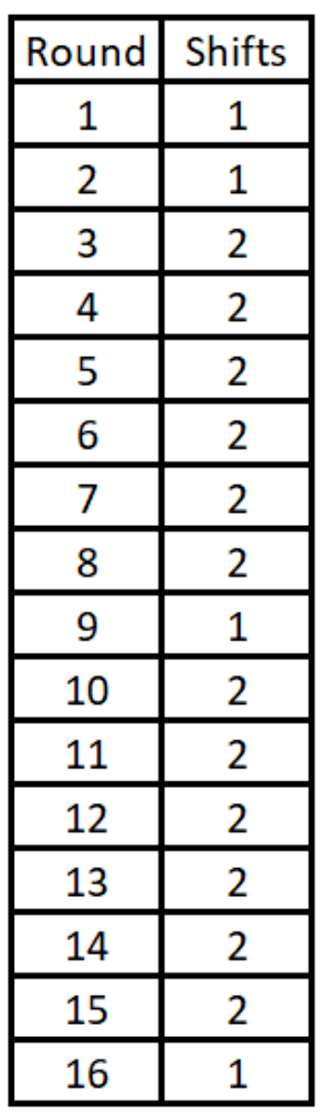
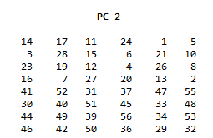
DES Steps – Key schedule
64-bit key input;
Permute key’s bits according to PC-1 -> 56 bits
The 57th bit of the key becomes the first bit, the 49th is the 2nd, and so on.
The 8 remaining bits were intended to be used as parity bits.
Split in half -> 2 28-bit halves, C & D
Left shift and store C & D 16 times, by 1 or 2 bits, based on schedule
Finally, each round’s C_{n}D_{n} pair is concatenated, and shifted according to PC-2 -> 48-bit round key K_{n}

Slide 5
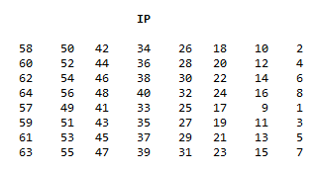
DES STEPS – Splitting and Rounds
Before splitting, permute the block according to Initial Permutation IP
Block’s 58th bit becomes the first bit, 50th -> 2nd, etc
Split in halves -> L₀ and R₀, 32-bits each.
For 16 rounds do
L_{n} = R_{n-1}
R_{n} = L_{n-1} XOR f(R_{n-1}, K_{n})
Notice the Swaps between the Left and Right halves, every round

Slide 6
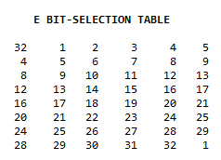
DES STEPS – Round function
First, expand the 32-bit R_{n-1} according to the table -> 48-bit E(R)
32nd bit becomes the first, 1st becomes the 2nd, etc.
XOR E(R) with the Round Key. -> 48-bit,
8 groups of 6 bits -> B₁, B₂, … B₈
These groups of 6 bits are used to shrink the 48-bit result back to a 32-bit value

Slide 7
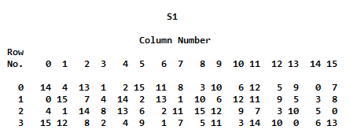
DES STEPS – Round function
Each of the 6-bit groups has a corresponding S-box
S₁, S₂, … S₈
6-bit values -> R₀ C₀C₁C₂C₃ R₁
R₀R₁ -> Binary values from 00-11 -> 0 to 3 Row index
Similarly, middle 4bits -> 0 to15 Column index
The output is the binary representation of the number indicated
S-box 1

Slide 8
DES STEPS – Round function
Example
Input: B₁ = (011011)
Row -> 01 binary -> 1 decimal
Column -> 1011 binary -> 11 decimal
S₁ Row 1 Col 11 -> 11
S₁(B₁) = Binary(11) = 1011
Repeat for all 8 6-bit groups and concatenate the results.
S-box 1

Slide 9
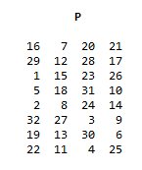
DES STEPS – Round function
The concatenated result is one last time permuted according to table P
This is the final output of the Round Function

Slide 10
Resources used
DES:
FIPS 46-3
J. Orlin Grabbe - The DES Algorithm Illustrated
Blowfish:
Schneier, B. (1994). Description of a new variable-length key, 64-bit block cipher (Blowfish). In: Anderson, R. (eds) Fast Software Encryption. FSE 1993. Lecture Notes in Computer Science, vol 809. Springer, Berlin, Heidelberg. https://doi.org/10.1007/3-540-58108-1_24
List of constants for use in Blowfish : https://www.schneier.com/wp-content/uploads/2015/12/constants-2.txt
RSA:

